Slide 1
intellicast: pre-retirement and transitioning to your permanent vacation

Slide 2
meet your intellicents team
Jonathan Perrin, CFP®
Financial Consultant
Designation and license background:
Certified Financial Planner - CFP®
FINRA Securities exam: Series 65
Life and Accident/Health Insurance

Slide 3
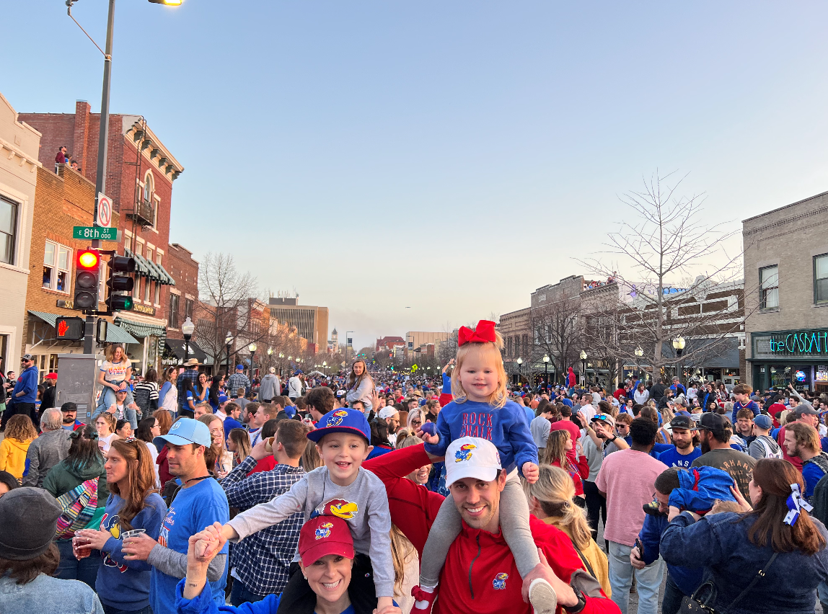
meet your intellicents team
Nick Madl, CFP®
Financial Consultant
Designation and license background:
Certified Financial Planner - CFP®
FINRA Securities exam: Series 7, 63, and 65
Years in the industry: 12

Slide 4
saving for retirement – three phases
transition
phase
income
phase
accumulation phase
preparing to retire
structured distributions during retirement
diversify investment allocations
building a portfolio
getting started
For illustrative purposes only.

Slide 5
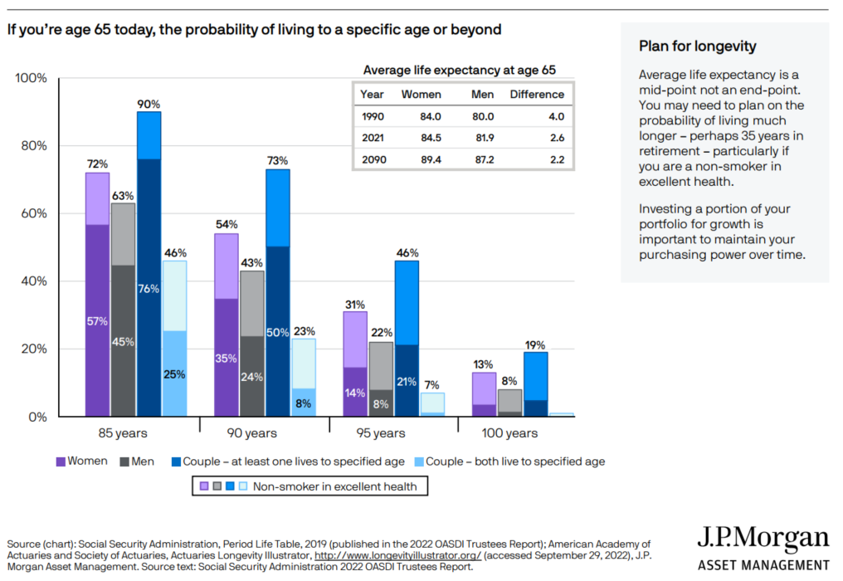
82%

Slide 6
how much of your income do you need?
Target
75% Replacement Income

Slide 7
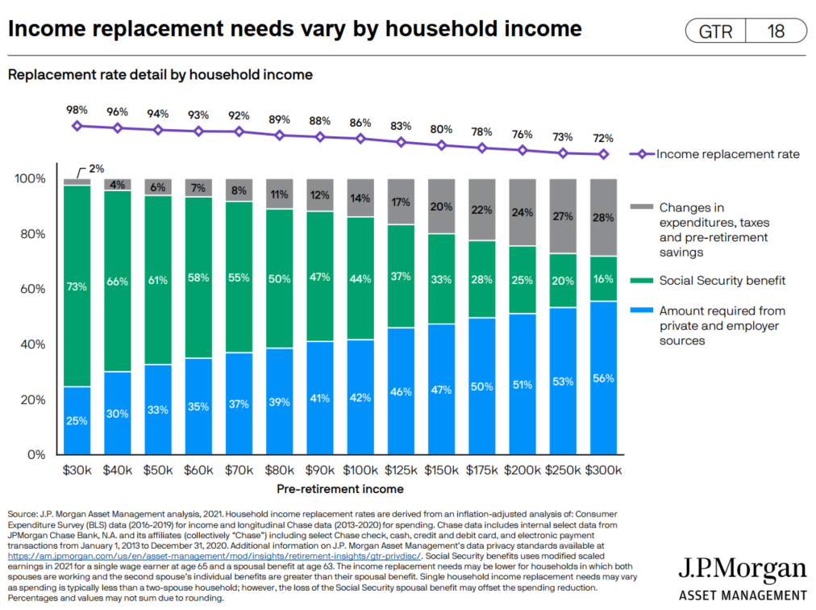
household income replacement

Slide 8
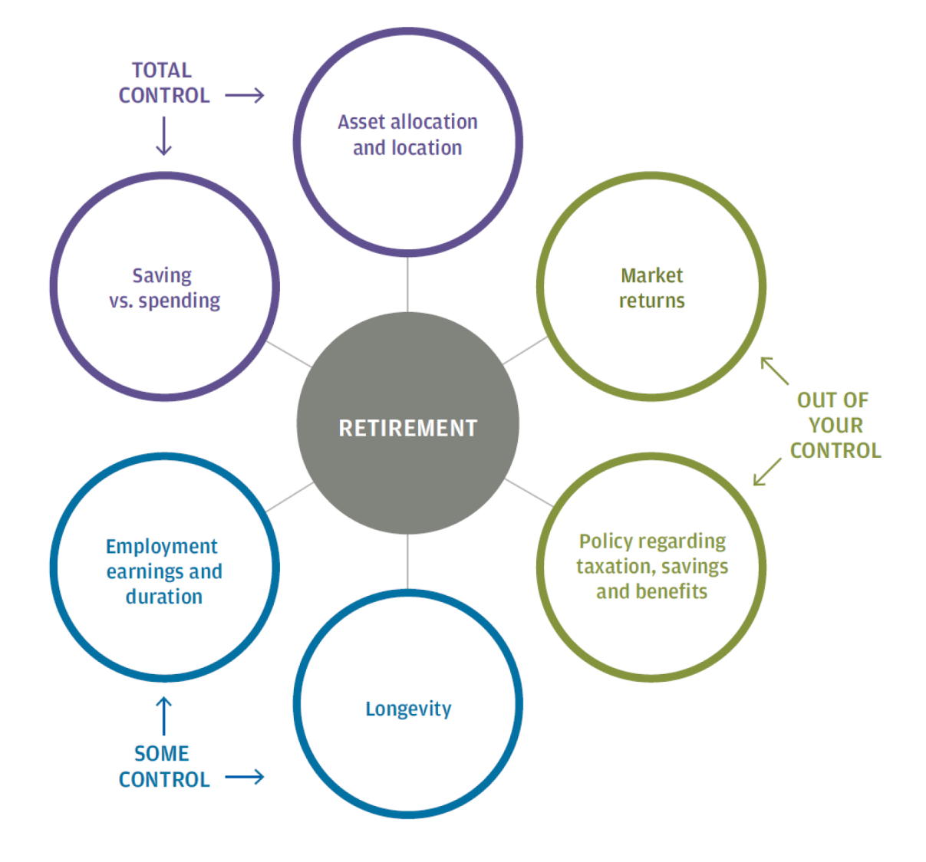
the retirement equation
A SOUND RETIREMENT PLAN
Make the most of the things that you can control but be sure to evaluate factors that are somewhat or completely out of your control within your comprehensive retirement plan.
Source: The Importance of Being Earnest, J.P. Morgan Asset Management, 2013.

Slide 9
withdrawal rate
How long will your assets last?
Assets
4% Withdrawal Rate
$1,000,000
$500,000
10%
8%
$0
9%
7%
6%
5% Withdrawal Rate
1979
1980
1981
1982
1983
1984
1985
1986
1987
1988
1989
1990
1991
1992
1993
1994
1995
1996
1997
1972
1998
1973
1974
1975
1976
1977
1978
1999
2000
2001
2002
2003
2004
2005
Couple
(Both Age 65)*
100% at Age 65
99% at Age 70
98% at Age 75
94% at Age 80
83% at Age 85
63% at Age 90
35% at Age 95
Source: Fidelity Investments. Hypothetical value of assets held in an untaxed account of $500,000 invested in a portfolio of 50% Stocks, 40% Bonds, and 10% Short-term investments with inflation adjusted withdrawal rates as specified. Hypothetical illustration uses historical monthly performance from January 1972 through December 2005 from Ibbotson Associates: stocks, bonds, and cash are represented by S&P 500, US Intermediate Term Government Bonds, and US 30 Day T-bill. Illustration uses actual historical inflation rates. This is for illustrative purposes only and not indicative of any investment. Past performance is no guarantee of future results. Probabilities of a couple surviving to various ages are based on Annuity 2000 Mortality Table from Society of Actuaries. Figures assume persons are in good health.

Slide 10
agenda
Investments in Retirement
Tax Planning
Social Security
Medicare / Healthcare
Takeaways
Q&A

Slide 11
asset allocation
90% of your ending return will be based upon how you allocate your assets among different investment styles (savings, bonds, or stocks).
Only 10% of your return will be due to the actual investment(s) that you choose.
Past performance is no guarantee of future results.
Source: Roger G. Ibbotson & Paul D. Kaplan (2000) Does Asset Allocation Policy Explain 40, 90, or 100 Percent of Performance?, Financial Analysts Journal, 56:1, 26-33, DOI: 10.2469/faj.v56.n1.2327

Slide 12
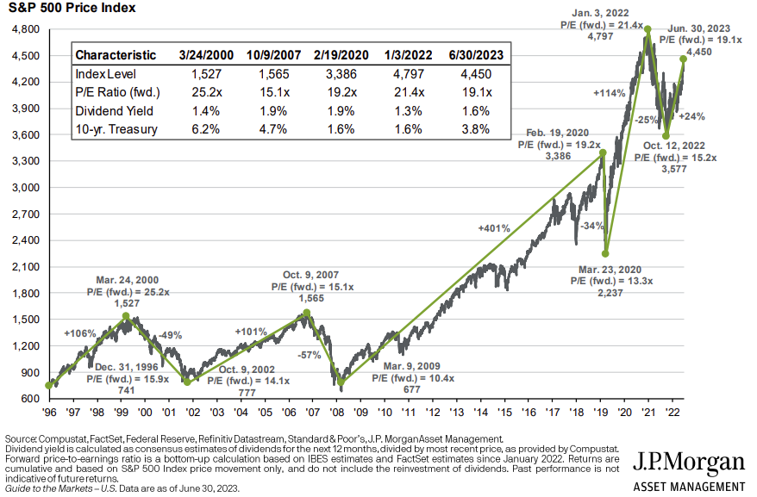
s&p 500 index at inflection points

Slide 13
bucket strategy sample household
Long Term Bucket
Stocks
Jim Roth IRA
Monica IRA
Joint Account
Short Term Bucket
Bonds
2-3 Years of Living Expenses
Jim 401(k)
Monica IRA
Joint Account
Checking Account (Monthly)

Slide 14
bucket approach to retirement planning
$1,000,000
20% loss for stocks
3% gain for bonds
$846,000
bucket approach
$800,000
20% loss for stocks
3% gain for bonds
$640,000
$200,000
$206,000
Long-Term
Long-Term
Short-Term
Short-Term
*assumes a portfolio invested 80% in stocks and 20% in bonds
Hypothetical Scenario; For Illustrative Purposes Only

Slide 15
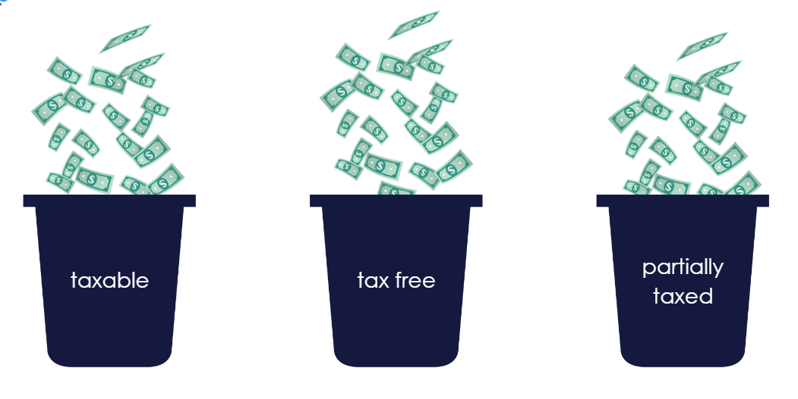
taxes on a “go forward” basis
how do we plan for it?
pre-tax 401k
Social Security**
traditional IRA
Roth 401k
Roth IRA
Health Savings Account
life insurance
after-tax savings and investments
annuities

Slide 16
distribution phase
Distributing taxable income can push you into a higher tax bracket
Increases
Adjusted Gross Income
SS Taxable
Medicare Premiums
Effective Tax Rate
taxable income
(Pre-Tax 401k / Pension)
Notes:
Married – if you’re receiving $2000 per month and you die, your spouse would receive $1000 per month for the remainder of his/her life.
“Unmarried individuals may choose the joint annuity option – they can choose anyone: a sibling, friend, etc.”
What’s biggest risk to a life annuity? Early death. Therefore “Term Certain” is simply a way to mitigate some of that risk and guarantee a payment to someone (yourself or your beneficiary) for at least that term period.

Slide 17
power of roth
82%
Assumptions: Saving $40 weekly from age 25 to age 65, 7% return

Slide 18
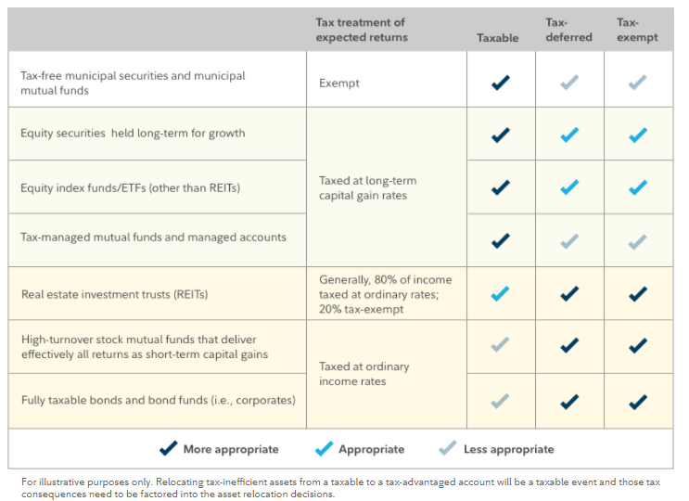
asset location
82%
Source: https://www.fidelity.com/viewpoints/investing-ideas/asset-location-lower-taxes

Slide 19
tax loss harvesting
pre-tax 401k
Social Security**
traditional IRA
Roth 401k
Roth IRA
Health Savings Account
life insurance
after-tax savings and investments
annuities

Slide 20
qualified charitable distribution (QCD)
Taxable
If you accept a distribution and then give the money away, the distribution is recorded as taxable income.
VS.
Non-Taxable
If you instruct your IRA administrator to make a distribution directly to a charity, you satisfy your RMD without adding to your taxable income.
IRA
You
Charity
IRA
You
Charity
Required Minimum Distributions being when you reach age 73 (70 ½ if you reached 70 ½ before January 1, 2020
Maximum distribution allowance is $100,000 per year per individual

Slide 21
health savings account
Maximum HSA Contributions | 2023 | 2024
Single | $3,850 | $4,150
Family | $7,750 | $8,300
55 and older catch-up (each spouse) | $1,000 | $1,000
Available with qualified high deductible health care plans.
What if I start H.S.A. at age 50…?
$7,000 per year
$1,000 catch up at age 55
2 % annual increase in contribution
8% market return
NO REIMBURSEMENTS
82%
AGE 67
$342,132
Hypothetical scenario. Return is for illustrative purposes only. Returns never come in straight line percentages. Calculations are using simple interest.

Slide 22
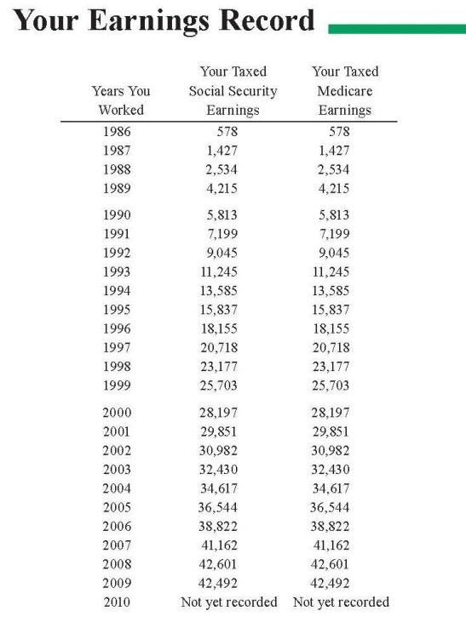
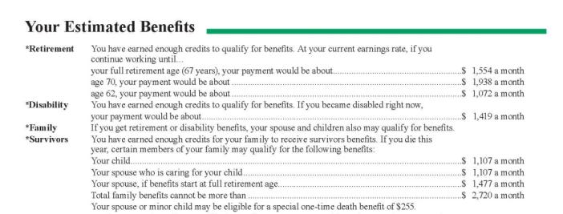
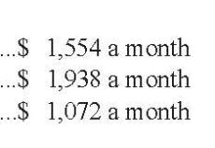
social security
Best 35 Years
Online Statements or Retirement Estimator
www.ssa.gov
Source: Social Security Administration (www.ssa.gov)

Slide 23
the tradeoff for individual benefits
Full Retirement Age
Age 62
Age 70
Reduced Benefits
Increased Benefits
Primary Insurance Amount (PIA)
Full Retirement Age (FRA)
65
1937 or earlier
66
1943-1954
67
1960 and later
Source: Social Security Administration (www.ssa.gov)

Slide 24
cost of collecting early
Percentage of FRA Benefits
Source: Social Security Administration (www.ssa.gov)

Slide 25
increases for collecting late
Percentage of FRA Benefits
Source: Social Security Administration (www.ssa.gov). Assumes individual born in 1943 or later

Slide 26
social security break-even analysis
Age 82.5
Age 78
62
75%
of PIA
66
100%
of PIA
70
132%
of PIA
Assumes individual has a Full Retirement age of 66.
Source: BlackRock; Securing Your Retirement: Transforming Social Security into a Winning Retirement Strategy.

Slide 28
Healthcare Costs In Retirement
The average couple retiring at 65 today will spend roughly $315,000 in retirement for out of pocket medical expenses*
example:
pay expenses from a pre-tax retirement account (401k or IRA)
20% effective tax rate
Gross Distribution: $375,000
Taxes: $75,000
Net Distribution: $300,000
Source: https://www.fidelity.com/viewpoints/personal-finance/plan-for-rising-health-care-costs

Slide 29
What Is Medicare?
Health Insurance for individuals:
65 and older
Under 65 with certain disabilities
Any age with End-Stage Renal Disease
Source: U.S. Centers for Medicare and Medicaid Services (www.medicare.gov)

Slide 30
Medicare Coverage Choices
Medicare Advantage Plan
Original Medicare
Part A
Hospitalization Room & Board
Part B
Medical & Physician Services
Part C
Offered by Private Insurance Companies
Combines
Part A, Part B, & usually Part D with additional benefits similar to a Medigap Supplement Plans
Most Part C plans cover prescription drugs. You may be able to add drug coverage to some plan types if not already included.)
Part D Prescription Drug Coverage
Medicare Supplement
(Medigap) Policy
Source: U.S. Centers for Medicare and Medicaid Services (www.medicare.gov)

Slide 31
Medicare Part B – Medical
Part B — Medical Services
Physician Services
Outpatient medical and surgical services, supplies
Clinical lab tests
Durable medical equipment
Diabetic testing supplies
Preventive services
Vison, Dental, Hearing Aids NOT COVERED
Source: U.S. Centers for Medicare and Medicaid Services (www.medicare.gov)

Slide 32
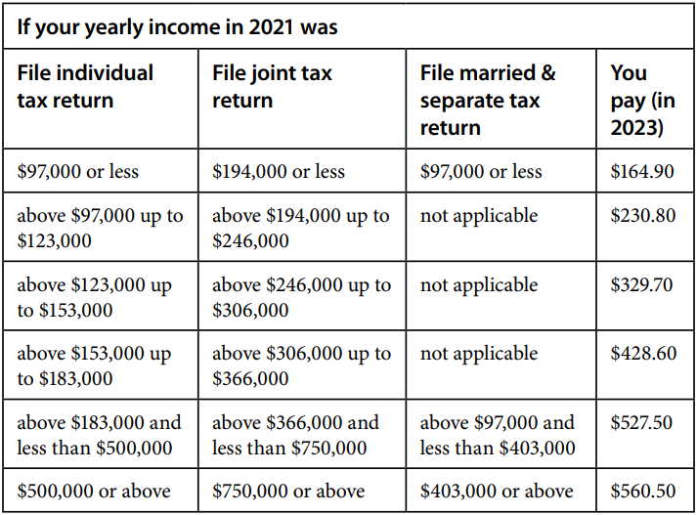
What You Pay – Part B
Source: U.S. Centers for Medicare and Medicaid Services (www.medicare.gov)

Slide 33
Part D – Prescription Drug
Available for all people with Medicare
Provided through:
Medicare Prescription Drug Plans (PDPs)
Medicare Advantage Prescription Drug Plans (MA-PDs)
Some other Medicare health plans
Source: U.S. Centers for Medicare and Medicaid Services (www.medicare.gov)

Slide 34
takeaways
Withdrawal rates are key to success
Tax planning plays a critical role in your withdrawal strategy
Investment allocations should align with cash flow needs
Analyze your Social Security and Medicare decisions
Long Term Care
Life Insurance
Estate Planning

Slide 35
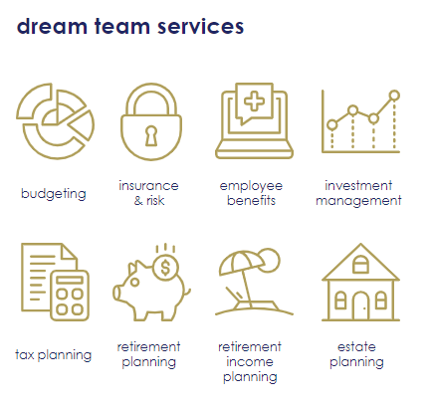
financial planning
Financial Plan
Free consultation
Discounted fee of $500 for one-time independent financial plan
Various payment options: monthly, quarterly, or annually
Learn more about us
Scan here

Slide 36
disclosures
upcoming intellicasts
Scan to register or visit intellicents.com/webinars
This presentation is provided for educational and information purposes only. Information and analysis obtained from outside sources is considered to be reliable but is not verified. Projections are not an indication of future results. Strategic asset allocation and diversification do not assure profit or protect against loss in declining markets. Any and all analyses and opinions presented in or along with this communication are subject to change without notice and no representation is made concerning actual future performance of the markets or economy.
This presentation is the property of intellicents and is intended solely for the use of the plan participants to whom it is addressed. This presentation may not be reproduced in any manner or re-distributed without the express consent of intellicents.
Investment Performance illustrated within this document does not reflect any plan related expenses that may be charged against your account. For additional information about these expenses, please refer to the annual fee disclosure provided by the plan administrator or contact them directly.
Investment advisory services offered through intellicents investment solutions, inc., an SEC registered investment adviser.

Slide 37
800.880.4015

