Slide 1
welcome to our spending plan + emergency savings intellicast!
we will start at 12pm CT
upcoming intellicasts
register at intellicents.com/webinars

Slide 2
intellicast: spending plan + emergency savings

Slide 3
meet your intellicents team
Lindsay Stout
financial consultant
Designation and license background:
FINRA Securities exam: Series 7 and 66
Life and Accident/Health Insurance

Slide 4
meet your intellicents team
Kyle Nelson, AIF® CPFA®
financial Consultant
Designation and license background:
FINRA Securities exam: Series 65
Accredited Investment Fiduciary - AIF®
Certified Plan Fiduciary Advisor - CPFA®

Slide 5
Budgeting, Debt, Savings, and Spending…. What do you need to know?
Budgeting
Tell your money where to go
Debt Servicing
Credit cards, loans, mortgages, and student loans, pay them ASAP
Saving for Future Events
Holidays, sporting events, etc.
Emergency Savings
Home repair, medical, loss of job, unexpected events

Slide 6
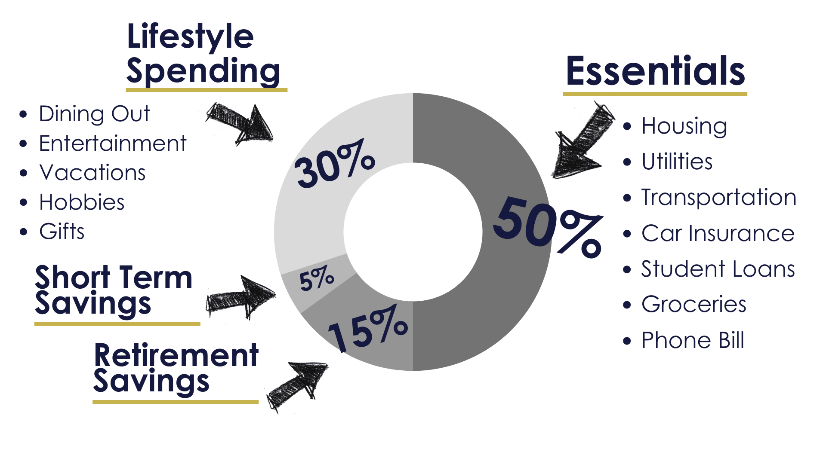
budgeting targets
Scan for budget spreadsheet
Make sure you are identifying any out of pattern expenses (holiday gifts, car maintenance, home repair and so on)

Slide 7
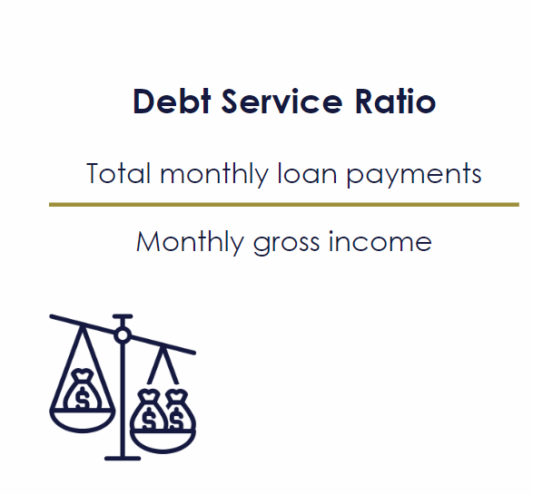
acceptable levels of debt
*for illustrative purposes only.

Slide 8
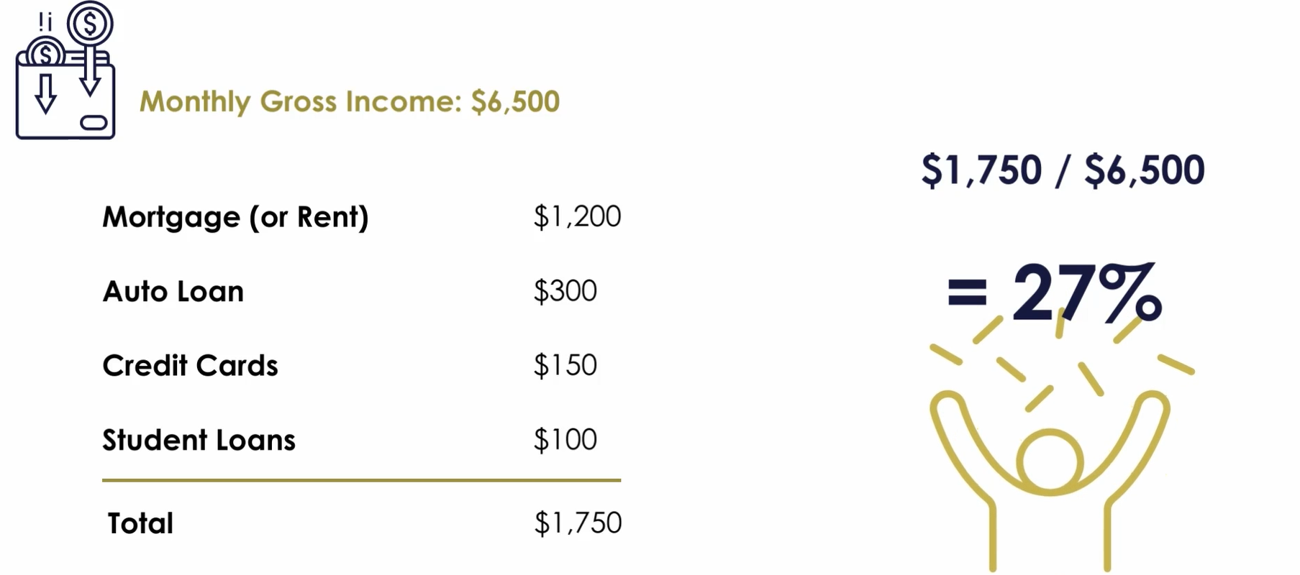
debt service ratio
*for illustrative purposes only.

Slide 9
debt avalanche method
pay debts in order of interest rate
start with the highest interest rate
focus on paying off one balance at a time in order of interest rate while still paying minimum balance on all other debts
benefit: pay debts off faster and pay less interest
debt snowball method
pay debts in order of balance amount
start with the smallest balance
if debts have the same balance put the debt with higher interest rate first
focus on paying off one balance at a time, in order of smallest to largest, while still making minimum payments on other debts
benefit: quick satisfaction

Slide 10
step 1: take an inventory of your debt
Debt | Balance | Rate | Minimum Payment
Credit Card #1 | $1,500 | 1.9% | $30
Credit Card #2 | $6,000 | 15.9% | $80
Student Loan | $11,000 | 7.4% | $130
Car Loan | $15,000 | 2.9% | $350
Home Equity | $30,000 | 10% | $250
*for illustrative purposes only.

Slide 11
step 2: choose a repayment method
snowball
avalanche
Debt | Balance | Rate | Minimum Payment
Credit Card #1 | $1,500 | 1.9% | $30
Credit Card #2 | $6,000 | 15.9% | $80
Student Loan | $11,000 | 7.4% | $130
Car Loan | $15,000 | 2.9% | $350
Home Equity | $30,000 | 10% | $250
Debt | Balance | Rate | Minimum Payment
Credit Card #2 | $6,000 | 15.9% | $80
Home Equity | $30,000 | 10% | $250
Student Loan | $11,000 | 7.4% | $130
Car Loan | $15,000 | 2.9% | $350
Credit Card #1 | $1,500 | 1.9% | $30
*for illustrative purposes only.

Slide 12
step 3: make minimum payments
Debt | Balance | Rate | Minimum Payment
Credit Card #1 | $1,500 | 1.9% | $30
Credit Card #2 | $6,000 | 15.9% | $80
Student Loan | $11,000 | 7.4% | $130
Car Loan | $15,000 | 2.9% | $350
Home Equity | $30,000 | 10% | $250
 |  | total | $840
*for illustrative purposes only.

Slide 13
step 4: apply extra principal payments
snowball
avalanche
Debt | Balance | Rate | Minimum Payment | Extra
Credit Card #1 | $1,500 | 1.9% | $30 | $200
Credit Card #2 | $6,000 | 15.9% | $80
Student Loan | $11,000 | 7.4% | $130
Car Loan | $15,000 | 2.9% | $350
Home Equity | $30,000 | 10% | $250
 |  | total | $840 | $200
Debt | Balance | Rate | Minimum Payment | Extra
Credit Card #2 | $6,000 | 15.9% | $80 | $200
Home Equity | $30,000 | 10% | $250
Student Loan | $11,000 | 7.4% | $130
Car Loan | $15,000 | 2.9% | $350
Credit Card #1 | $1,500 | 1.9% | $30
 |  | total | $840 | $200
*for illustrative purposes only.

Slide 14
step 5: roll payments as debts pay off
snowball
avalanche
Debt | Balance | Rate | Minimum Payment | Extra
Credit Card #1 | $0 | 1.9%
Credit Card #2 | $6,000 | 15.9% | $80 | $230
Student Loan | $11,000 | 7.4% | $130
Car Loan | $15,000 | 2.9% | $350
Home Equity | $30,000 | 10% | $250
 |  | total | $810 | $230
Debt | Balance | Rate | Minimum Payment | Extra
Credit Card #2 | $0 | 15.9%
Home Equity | $30,000 | 10% | $250 | $280
Student Loan | $11,000 | 7.4% | $130
Car Loan | $15,000 | 2.9% | $350
Credit Card #1 | $1,500 | 1.9% | $30
 |  | total | $760 | $280
*for illustrative purposes only.

Slide 15
debt avalanche method
step 6: freedom from debt!
pros:
save you money in the long run
saves you time overall to pay off all your debt
cons:
can take a while to see noticeable changes in your debt
requires a lot of self discipline to continue to work towards your goals
debt snowball method
pros:
you will start to see progress quickly
easier to stick to goals
cons:
takes longer to pay down all debts
cost you more in interest in the long run

Slide 16
what is a sinking fund?
An account that is established for accumulating funds to meet a future obligation or goal
categories
Vacation
Holiday season
Travel
Back to school
Car insurance
Life insurance
Childcare
Taxes
Wedding
Home maintenance

Slide 17
1
set target
amount to save
goal:
$3,000
*for illustrative purposes only.

Slide 18
1
2
set target
amount to save
determine date needed by
goal:
$3,000
date needed:
october

Slide 19
1
2
3
set target
amount to save
determine date needed by
calculate time
period to save
goal:
$3,000
date needed:
october
number of months:
10 (january-october)
*for illustrative purposes only.

Slide 20
1
2
3
4
set target
amount to save
determine date needed by
calculate time
period to save
calculate periodic savings amount
goal:
$3,000
date needed:
october
number of months:
10 (january-october)
$3,000/10 months:
$300 per month
*for illustrative purposes only.

Slide 21
1
2
3
4
5
set target
amount to save
determine date needed by
calculate time
period to save
calculate periodic savings amount
save
goal:
$3,000
date needed:
october
number of months:
10 (january-october)
$3,000/10 months:
$300 per month
*for illustrative purposes only.

Slide 22
emergency savings fund
What is an Emergency Savings Fund?
Money set aside for urgent & unplanned life events
How much do I need?
Goal 1: $1,000
Goal 2: $5,000
Goal 3: 3-6 months of expenses
Where should I keep it?
High-interest savings account (or short-term low-risk investments). Keep it separate from your checking account.
Medical
Expenses
Car Repairs
Home Repairs
Job Loss

Slide 23
Apply the method

Slide 24
monthly income
after-tax salary or wages
$4,000
partner after-tax wages
$4,000
any additional income
$0
total
$8,000
*for illustrative purposes only.

Slide 25
essentials
rent/mortgage
$1,500
phone
$100
electricity
$200
gas
$50
water and sewer
$30
internet
$100
vehicle payment
$300
car insurance
$200
groceries, toiletries, and essentials
$1,000
student loan
$300
child care expenses
$800
total
$4,580
*for illustrative purposes only.

Slide 26
lifestyle spending
Amazon
$20
Netflix
$20
home decor
$500
dining out
$400
movie, concert, sports tickets
$300
music streaming services
$10
gym membership
$100
clothing
$300
pet food
$20
credit card payment
$300
total
$1,970
*for illustrative purposes only.

Slide 27
savings
emergency savings fund
$200
savings account contribution
$200
IRA
$100
401(k)*
$600
*Your 401(k) contribution does not factor into your overall expenses as your contributions have already been deducted from your paycheck. However, these contributions amounts will factor into the Categories percentage calculations below.
total
$1,100
*for illustrative purposes only.

Slide 28
summary
net income
$8,000
essentials
($4,580)
lifestyle
($1,970)
savings
($500)
surplus
$950
*for illustrative purposes only.

Slide 29
VS
emergency fund
sinking fund
unexpected expenses
infrequent but planned expenses
3-6 months of your after-tax income
varies depending on goal
kept in a separate place
can be kept in multiple accounts

Slide 30
disclosures
upcoming intellicasts
Scan to register or visit intellicents.com/webinars
This presentation is provided for educational and information purposes only. Information and analysis obtained from outside sources is considered to be reliable but is not verified. Projections are not an indication of future results. Strategic asset allocation and diversification do not assure profit or protect against loss in declining markets. Any and all analyses and opinions presented in or along with this communication are subject to change without notice and no representation is made concerning actual future performance of the markets or economy.
This presentation is the property of intellicents and is intended solely for the use of the plan participants to whom it is addressed. This presentation may not be reproduced in any manner or re-distributed without the express consent of intellicents.
Investment Performance illustrated within this document does not reflect any plan related expenses that may be charged against your account. For additional information about these expenses, please refer to the annual fee disclosure provided by the plan administrator or contact them directly.
Investment advisory services offered through intellicents investment solutions, inc., an SEC registered investment adviser.

Slide 31
800.880.4015

