Slide 1
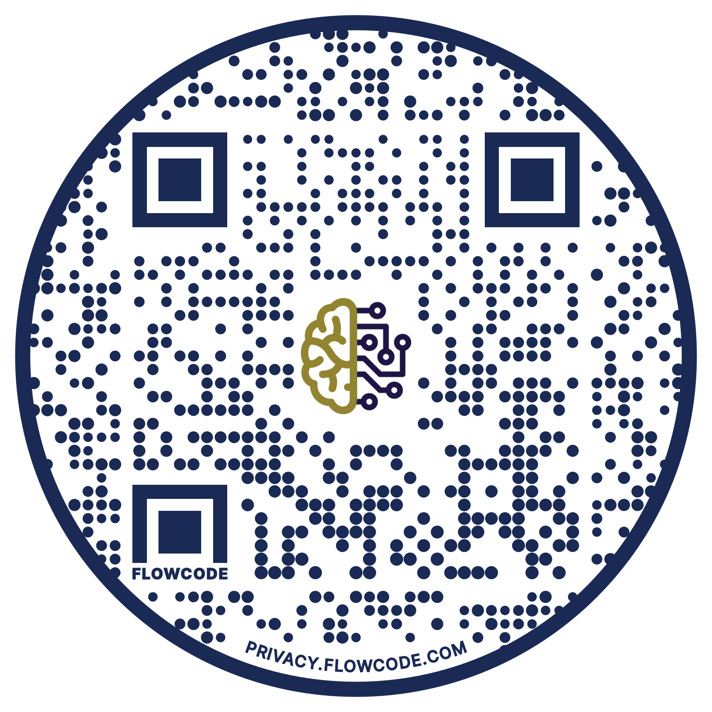
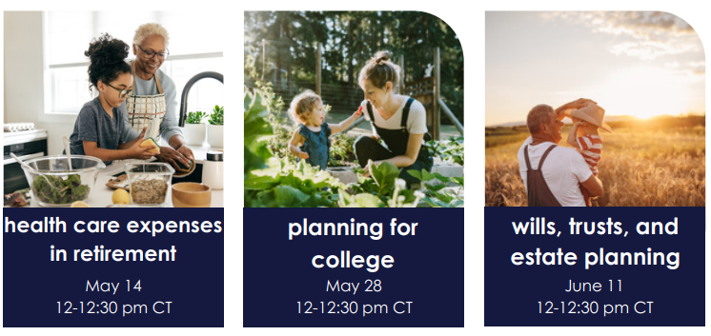
welcome to our back to basics: investments 101 intellicast!
upcoming intellicasts
register at intellicents.com/webinars

Slide 2
intellicast back to basics: investments 101

Slide 3
meet your intellicents team
Kevin Atnip
financial consultant
Designation and license background:
FINRA Securities exam: Series 65

Slide 4
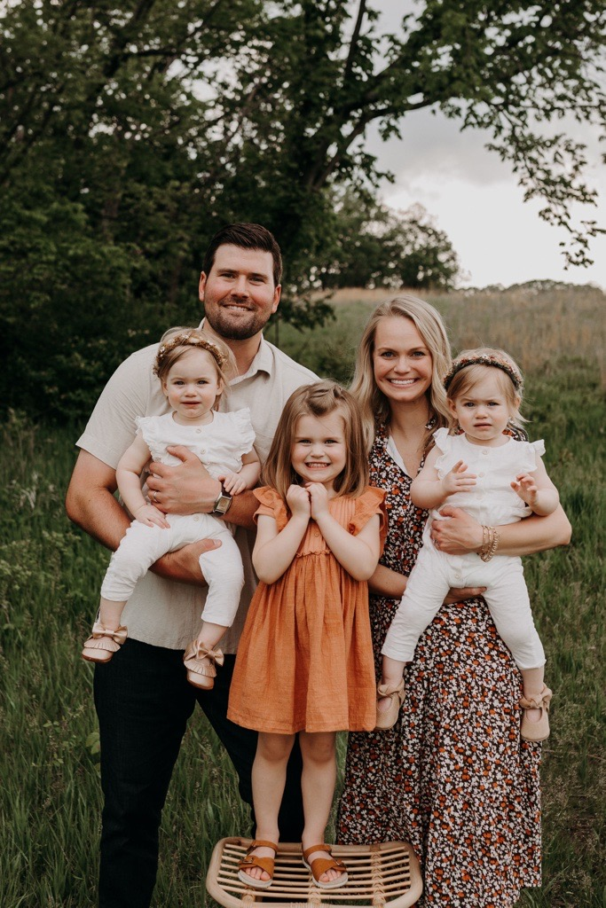
meet your intellicents team
Brandon Budd, AIF® RICP ®
President of Retirement Services
Designation and license background:
Accredited Investment Fiduciary- AIF®
FINRA Securities exam: Series 65
Life and Accident/Health Insurance

Slide 5
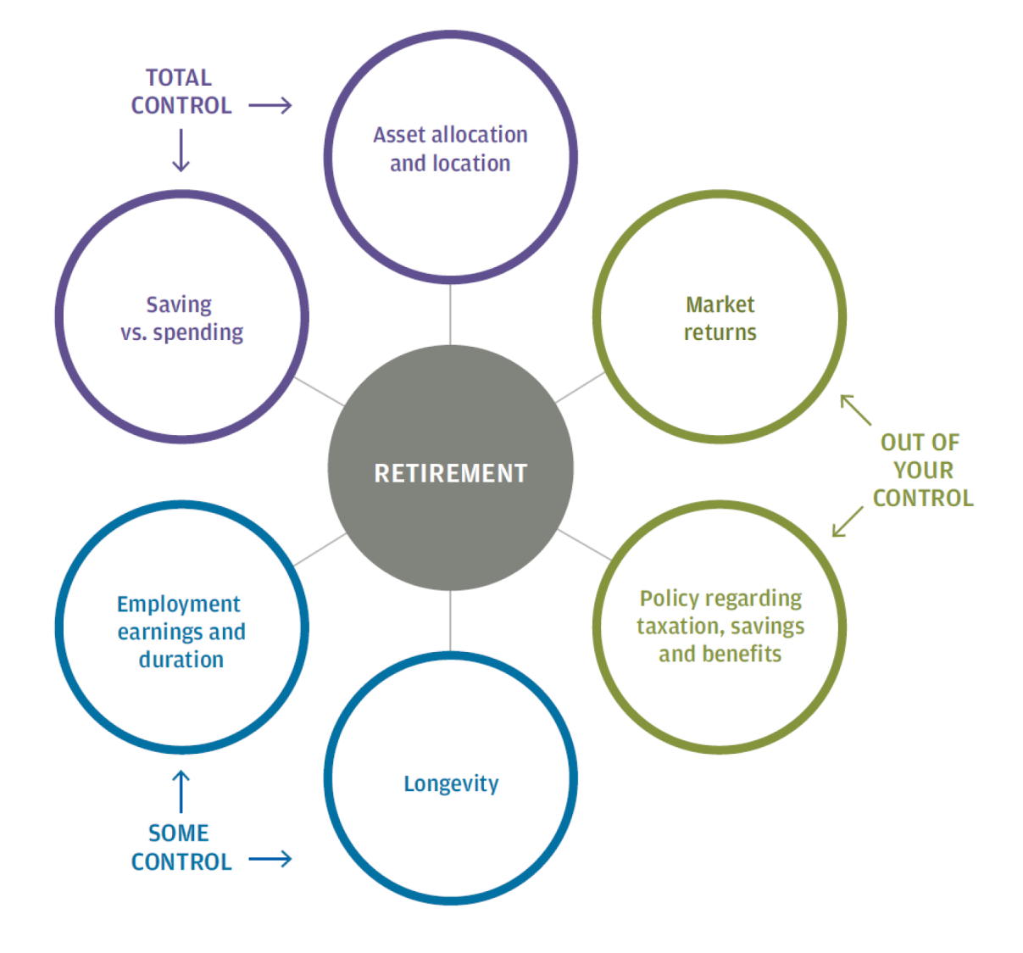
the retirement equation
A SOUND RETIREMENT PLAN
Make the most of the things that you can control but be sure to evaluate factors that are somewhat or completely out of your control within your comprehensive retirement plan.
Source: The Importance of Being Earnest, J.P. Morgan Asset Management, 2013.

Slide 6
investment fundamentals
What is Cash?
Focused on risk aversion
What is a Stock?
Ownership in the company
You make money when the price of the stock goes up.
What is a Bond?
A Loan
You make money based on the interest.
What is a Mutual Fund?
A pool of many stocks or bonds.
You make money through interest and increases in stock prices. It depends on the mutual fund.
Notes:
Look at graphics, add cash as the top point

Slide 7
asset allocation
The process of developing a diversified investment strategy by mixing different assets in varying proportions.
90% of your ending return will be based upon how you allocate your assets among different investment styles (savings, bonds, or stocks).
Only 10% of your return will be due to the actual investment(s) that you choose.
Past performance is no guarantee of future results.
Source: Roger G. Ibbotson & Paul D. Kaplan (2000) Does Asset Allocation Policy Explain 40, 90, or 100 Percent of Performance?, Financial Analysts Journal, 56:1, 26-33, DOI: 10.2469/faj.v56.n1.2327

Slide 8
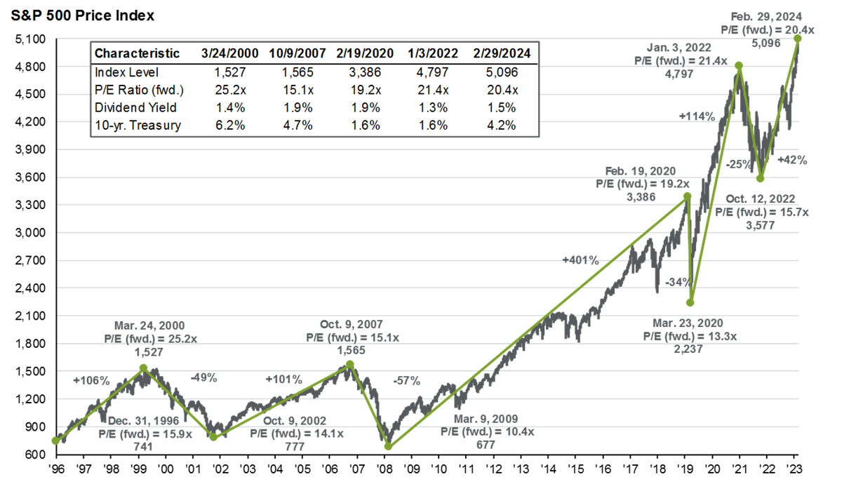
s&p 500 index at inflection points
Sources: FactSet, S&P and JPMorgan Asset Management
Disclosure: Past Performance is not Indicative of Future Returns.

Slide 9
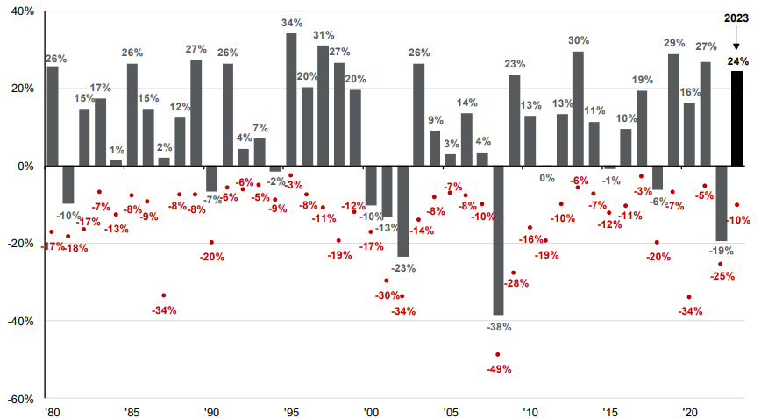
S&P 500 Index Calendar Year Returns and Intra-year Declines
Sources: FactSet, S&P and JPMorgan Asset Management
Disclosure: Past Performance is not Indicative of Future Returns.

Slide 10
example: how much you save
Assumptions: 25 year old, saving $10 weekly until age 65, Rate-of-Return 7%
Hypothetical scenario; for illustrative purposes only.

Slide 11
example: how long you save
Assumptions: Saving $40 weekly until age 65, Rate-of-Return 7%
Hypothetical scenario; for illustrative purposes only.

Slide 12
example: what you earn
93%
82%
Interest Rate
Assumptions: Saving $40 weekly from age 25 to age 65
Hypothetical scenario; for illustrative purposes only.

Slide 13
determine your asset allocation
Plot Goals for Your Time Horizon
25+ Years Until Retirement
Consider Aggressive or Moderately Aggressive
15 Years Until Retirement
Consider Moderately Aggressive
or Moderate
5 Years Until Retirement
Consider Moderate or
Moderately Conservative
Individual needs may vary based on various factors. Please consult a financial professional.

Slide 14
participant investment strategies
Notes:
Maranda to update with graphics from video

Slide 15
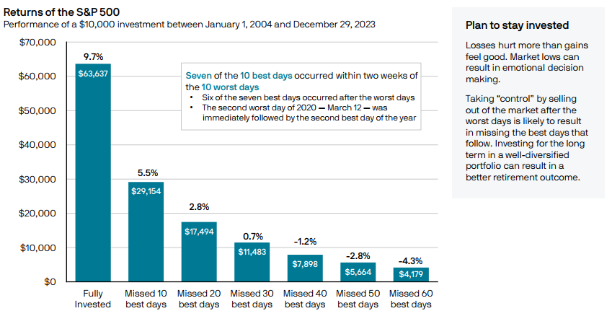
impact of being out of the market
Source: J.P. Morgan Asset Management analysis using data from Bloomberg. Returns are based on the S&P 500 Total Return Index, an unmanaged, capitalization-weighted index that measures the performance of 500 large capitalization domestic stocks representing all major industries. Indices do not include fees or operating expenses and are not available for actual investment. The hypothetical performance calculations are shown for illustrative purposes only and are not meant to be representative of actual results while investing over the time periods shown. The hypothetical performance calculations are shown gross of fees. If fees were included, returns would be lower. Hypothetical performance returns reflect the reinvestment of all dividends. The hypothetical performance results have certain inherent limitations. Unlike an actual performance record, they do not reflect actual trading, liquidity constraints, fees and other costs. Also, since the trades have not actually been executed, the results may have under- or overcompensated for the impact of certain market factors such as lack of liquidity. Simulated trading programs in general are also subject to the fact that they are designed with the benefit of hindsight. Returns will fluctuate and an investment upon redemption may be worth more or less than its original value. Past performance is not indicative of future returns. An individual cannot invest directly in an index. Data as of December 31, 2023.

Slide 16
time, diversification, and returns
range of stock, bonds, and blended returns
annual totals 1950-2023

Slide 17
disclosures
upcoming intellicasts
Scan to register or visit intellicents.com/webinars
This presentation is provided for educational and information purposes only. Information and analysis obtained from outside sources is considered to be reliable but is not verified. Projections are not an indication of future results. Strategic asset allocation and diversification do not assure profit or protect against loss in declining markets. Any and all analyses and opinions presented in or along with this communication are subject to change without notice and no representation is made concerning actual future performance of the markets or economy.
This presentation is the property of intellicents and is intended solely for the use of the plan participants to whom it is addressed. This presentation may not be reproduced in any manner or re-distributed without the express consent of intellicents.
Investment Performance illustrated within this document does not reflect any plan related expenses that may be charged against your account. For additional information about these expenses, please refer to the annual fee disclosure provided by the plan administrator or contact them directly.
Investment advisory services offered through intellicents investment solutions, inc., an SEC registered investment adviser.
Certified Financial Planner Board of Standards, Inc. (CFP Board) owns the certification marks CFP®, CERTIFIED FINANCIAL PLANNER™, and CFP® (with plaque design) in the United States, which it authorizes use of by individuals who successfully complete CFP Board’s initial and ongoing certification requirements.

Slide 18
800.880.4015

